Slide 1
Programming Practice 01
In a Colab Cell, write code to do the following:
> for each of the integers 0-9, print out the > int plus 5
Challenge:
> define a function that would accept any
> highest integer, instead of only going to 9

Slide 2
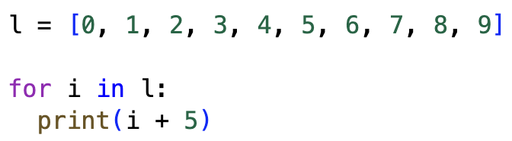
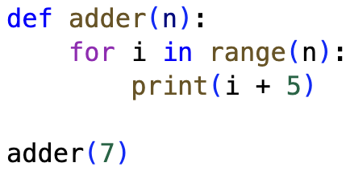
Programming Practice Solution 01
NOTE: We can read about built-in features like range using the python documentation!

Slide 3
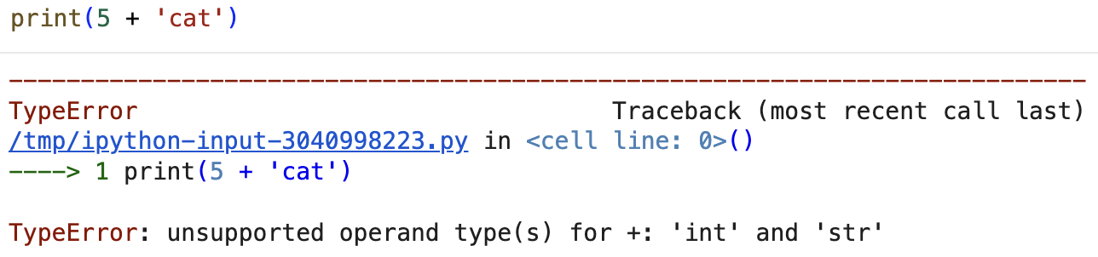
Type Errors
Last class we saw an error when we tried to add an int and a str together.

Slide 4
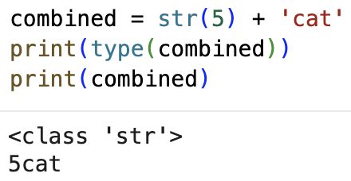
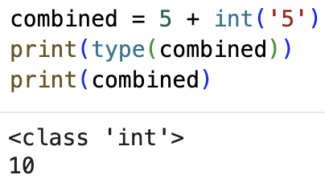
Typecasting
Typecasting allows us to change a variable or value to a different (supported) type!
NOTE: It is especially useful to typecast str into an int because usually when we read in data from a file, it all comes in as str

Slide 5
Programming Practice 02
define a function that can, given a list of ints, return a dictionary of counts of consecutive pairs.
For example:
pairs = count_consecutive_pairs([1, 2, 3, 1, 2])
print(pairs)
> {(1, 2): 2, (2, 3): 1, (3, 1): 1}

Slide 6
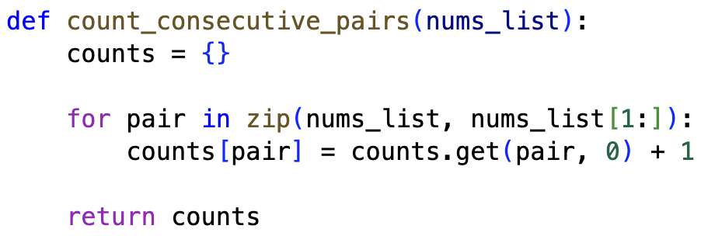
Programming Practice Solution 02
NOTE: .get(key, default) allows us to specify a backup value to return if the key doesn’t already exist in the dictionary

Slide 7
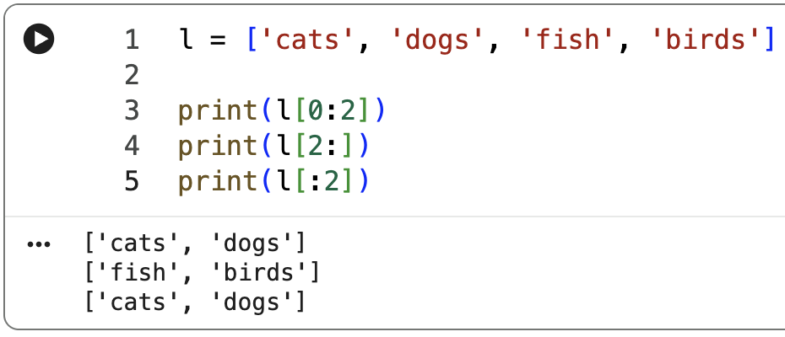
programming: List Slices
List slices allow us to access regions of the list instead of just individual values.
NOTE: In a list slice, the first index is inclusive, the second isn’t

Slide 8
CSE 10124
Tokenization 01

Slide 9
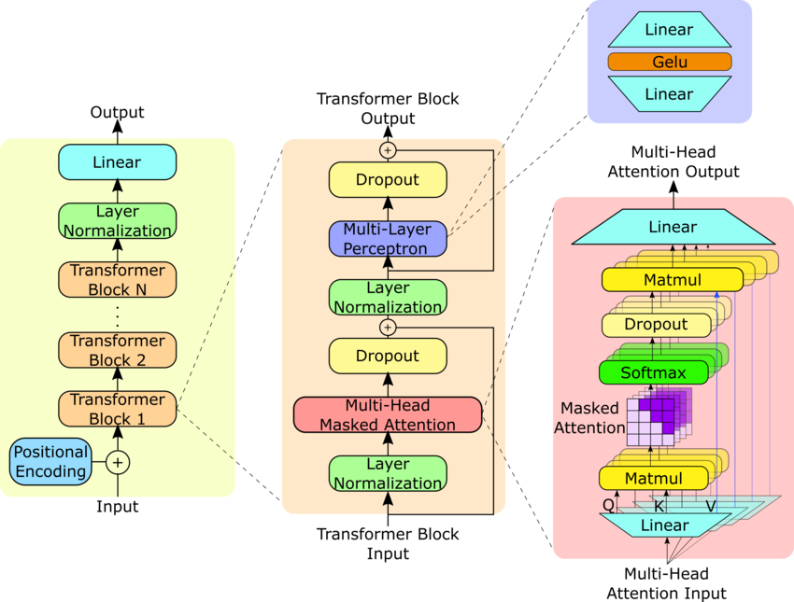
Where are we?
Response: “Certainly, as a large language model I’d be happy to help you cheat on your homework assignment”
Embeddings
Tokenizer
“Please help me with my homework!!”

Slide 10
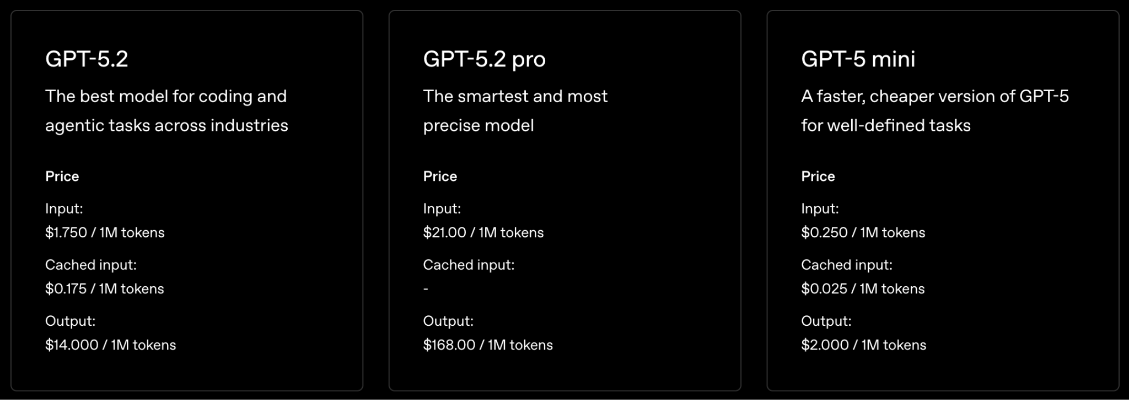
Tokens Today — OpenAI API
NOTE: An API is a set of URLs that allow code to access things automatically (like AI models)

Slide 11
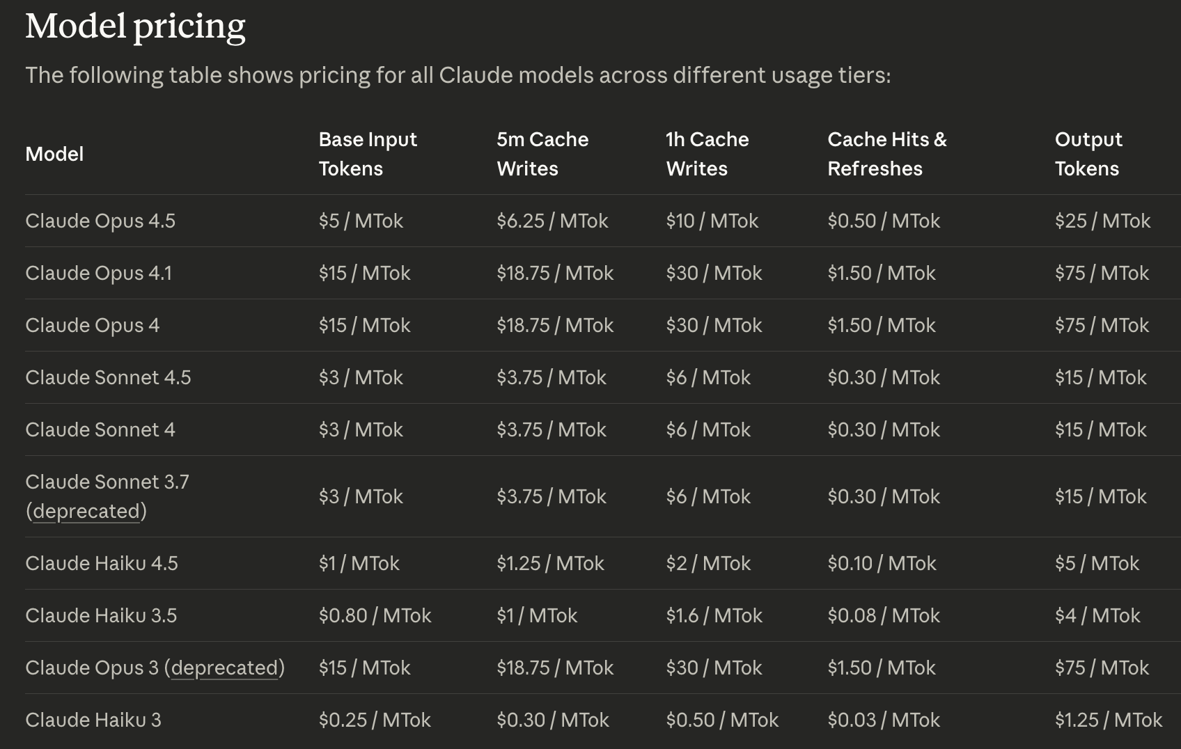
Tokens Today — Anthropic API

Slide 12
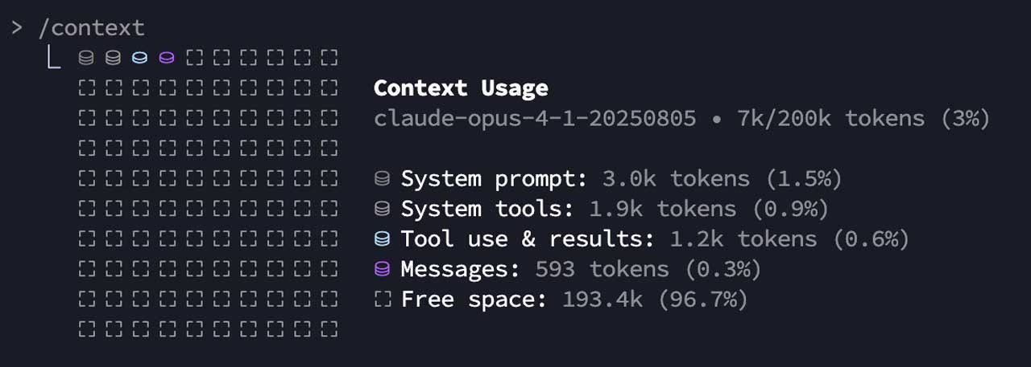
Tokens Today — Claude Code

Slide 13

Last Class - Text as Data
jabberwocky.txt
"Jabberwocky"
by Lewis Carroll
'Twas brillig, and the slithy toves
Did gyre and gimble in the wabe;
All mimsy were the borogoves,
And the mome raths outgrabe.
"Beware the Jabberwock, my son!
The jaws that bite, the claws that catch!
Beware the Jubjub bird, and shun
The frumious Bandersnatch!"
He took his vorpal sword in hand:
Long time the manxome foe he sought—
So rested he by the Tumtum tree,
And stood awhile in thought.
NOTE: Markov Graph Visualizer

Slide 14
Why do we Tokenize?
Machine Readability: Models work with numbers, not letters; tokens become numerical IDs for the model to understand relationships and context.
Efficiency & Scalability: Breaking text into subwords (like "help" + "ful") reduces the vocabulary size, meaning fewer unique items to learn, making models smaller and faster than word-based methods.
Handling Novelty: Subword tokenization (like BPE) helps models understand new or misspelled words by breaking them into known parts, improving robustness.
Contextual Understanding: It provides granular units (tokens) for the model to predict the next element in a sequence, forming the basis of its language generation.

Slide 15
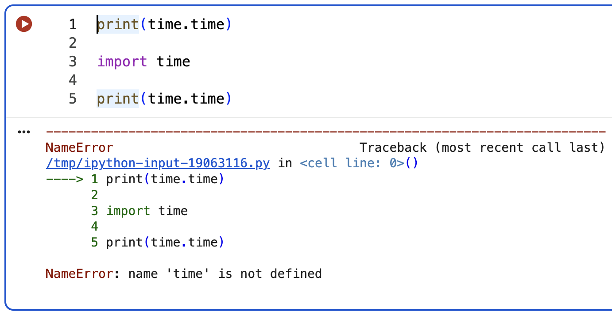
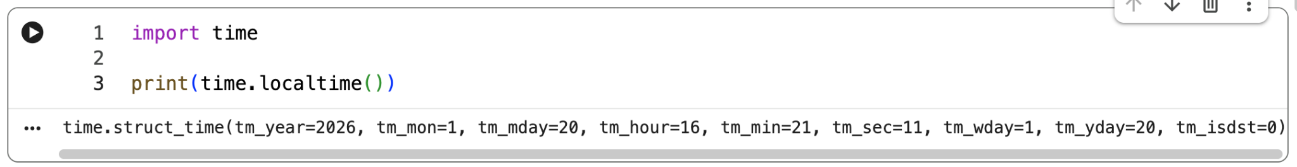
programming: Imports
Imports allow us to access useful functions that are not built-in to python.
NOTE: These are almost always at the top of the file

Slide 16
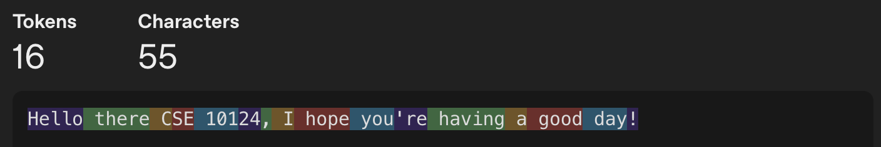
What is a Token?
“Tokens are words, character sets, or combinations of words and punctuation that are generated by LLMs when they decompose text.”
— Microsoft

Slide 17
Tokenization
“Tokens are words, character sets, or combinations of words and punctuation that are generated by LLMs when they decompose text.”
— Microsoft

Slide 18
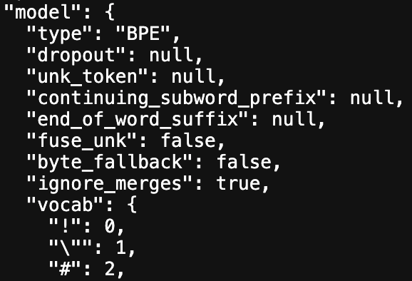
Byte-Pair Encoding Tokenization (1994)
BPE is an algorithm for encoding strings of text into smaller strings by creating and using a translation table.
A slightly modified version of the algorithm is used in LLM tokenizers
NOTE: The size of the token vocabulary, in the case of GPT-3.5 and GPT-4, is 100258 tokens.

Slide 19
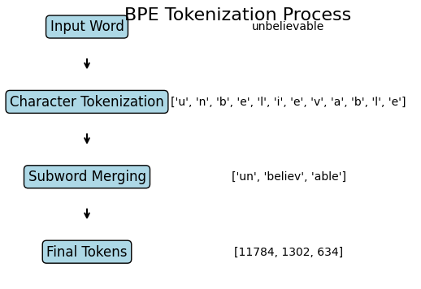
Byte-Pair Encoding Tokenization (1994)

